Slide 1
PRESERVATION
A CURLYFRIES PRODUCTION
By: James Becker, Aaron Gupta, Andrew Watson,
Xavier Chan, Keith Pardee

Slide 2
STORYLINE/PLOT
IN THE YEAR 20XX, THE WORLD HAS SUFFERED THE EXTINCTION OF ALL THE ANIMALS. YOU, A ZOOLOGIST, MUST FIND A WAY TO REPOPULATE THE PLANET. FORTUNATELY, THE PROFESSOR HAS JUST FINISHED THE TIME DISPLACEMENT DEVICE. NOW YOU MUST GO RETRIEVE MEMBERS OF EXTINCT SPECIES. SAVE THE PLANET!

Slide 3
WIN / LOSE CONDITION
WIN CONDITION:
FREE ALL ANIMALS IN EVERY LEVEL
CLEAR ALL LEVELS
LOSE CONDITION:
ZOOKEEPER’S HP HITS ZERO
ZOOKEEPER DOES NOT FREE/RESCUE ANIMALS WITHIN THE ALLOTTED TIME (POTENTIALLY)

Slide 4
POTENTIAL UPGRADES
VARIOUS UPGRADES ACQUIRED AFTER STUNNING BOSS POACHER
EXAMPLES OF UPGRADES
DOUBLE JUMP
FLY
TREE CLIMBING
INVISIBILITY
FREEZE

Slide 5
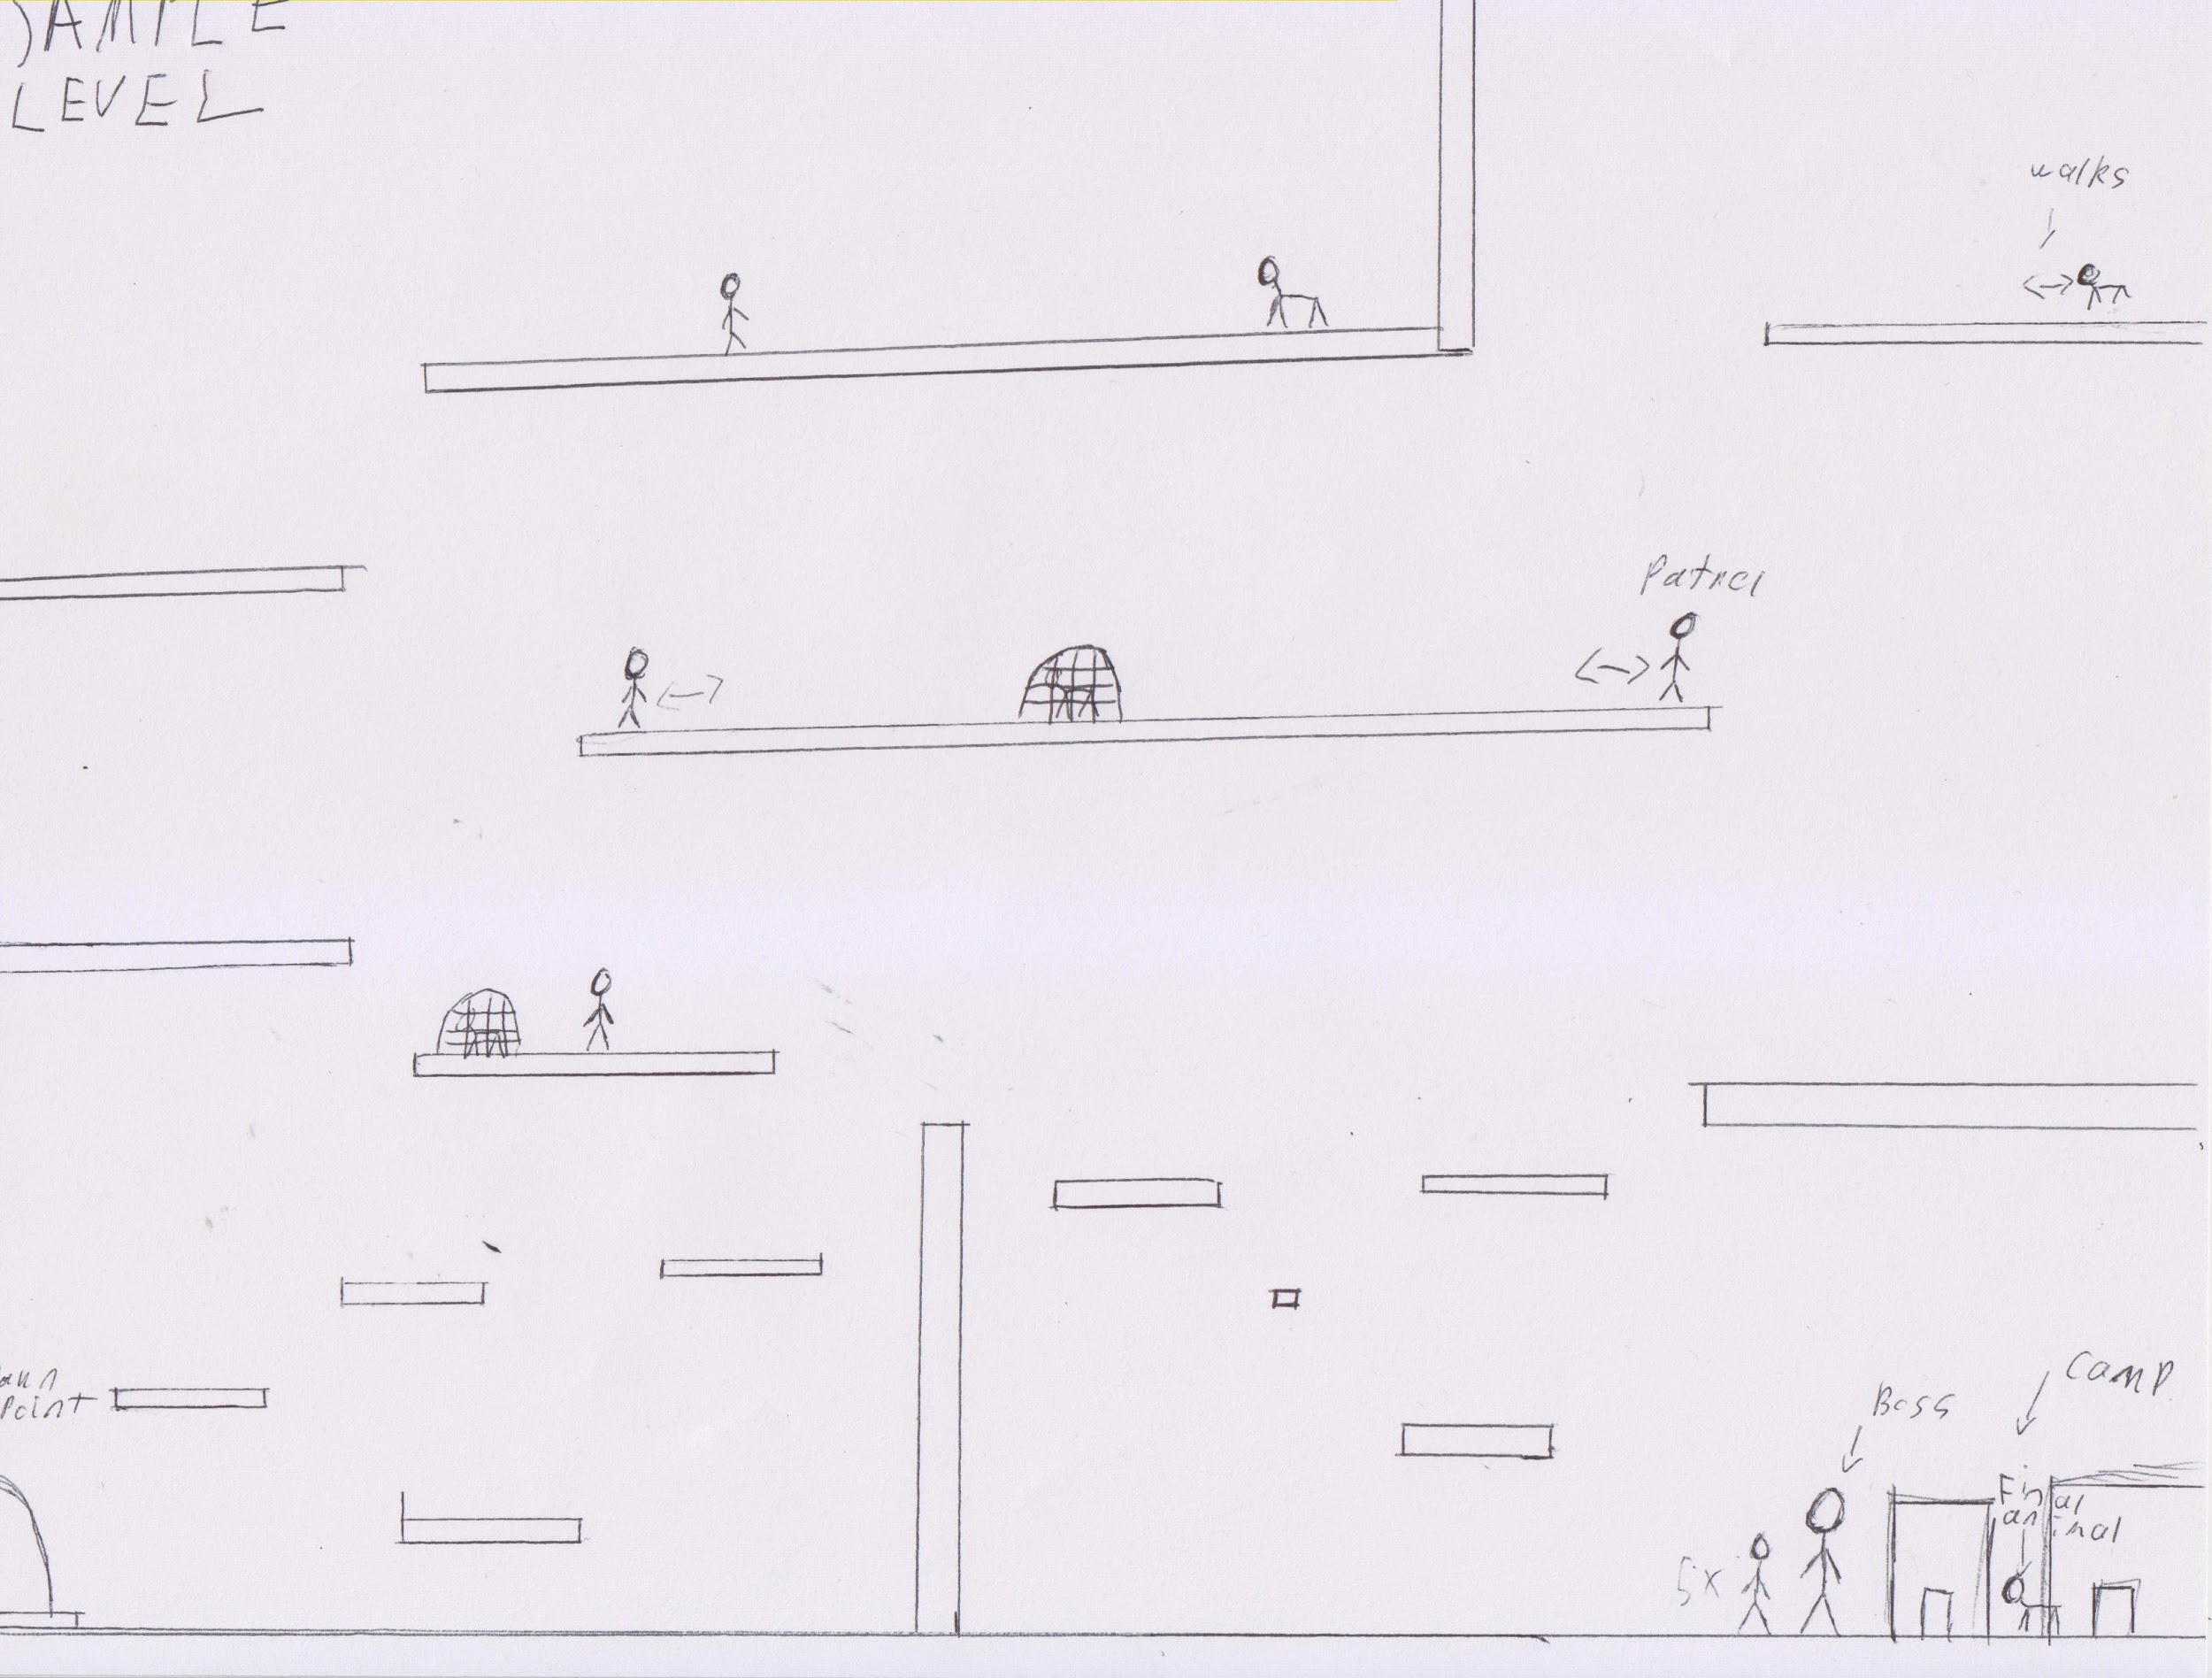
LEVEL DESIGN
Notes:
James

Slide 6
LEVELS
DIFFERENT TYPES OF POACHERS INTERACT WITH THE ZOOKEEPER IN ENTIRELY DIFFERENT WAYS!!
LEVEL 1 - ARCTIC, 2037:
ICEY BACKGROUND
ARCTIC FOX TRAPPERS
EASIEST ENEMIES
LESS DAMAGE & QUANTITY
USE BOLAS
ICE CRUNCHING NOISES FOR WALKING
LEVEL 2 - MADAGASCAR, 1660’S:
RAINFOREST
EXPLORERS/DODO HATERS
FASTER; USES BOW AND ARROW
KNOWS TERRAINS
CLIMB TREES & WALLS
LEAF CRUNCHING NOISES
LEVEL 3 - ANCIENT AMERICA, ~10000 B.C.
GRASSLAND
CAVEMEN
MORE HP & DAMAGE
THROW SPEARS
CAVE ECHO SOUNDS
WATER DRIPPING
Notes:
James

Slide 7
CONCEPTUAL ARTWORK

Slide 8


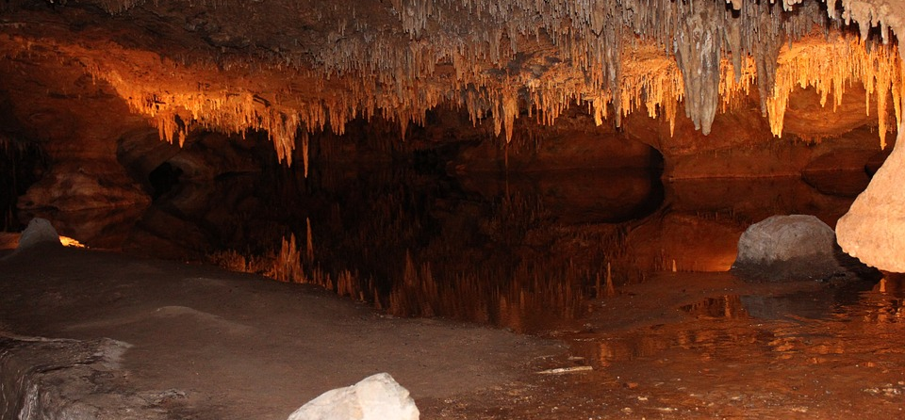
BACKGROUNDS
LEVEL 1
LEVEL 2
LEVEL 3
ARCTIC
2037
Referencce: https://pixabay.com/en/northern-lights-aurora-borealis-984120/
RAINFOREST
1660s
Reference: https://pixabay.com/en/ferns-tree-ferns-australia-sydney-303016/
CAVE
~10,000 B.C.
Reference: https://pixabay.com/en/luray-virginia-caves-caverns-184172/

Slide 9

GAME TITLE

Slide 10
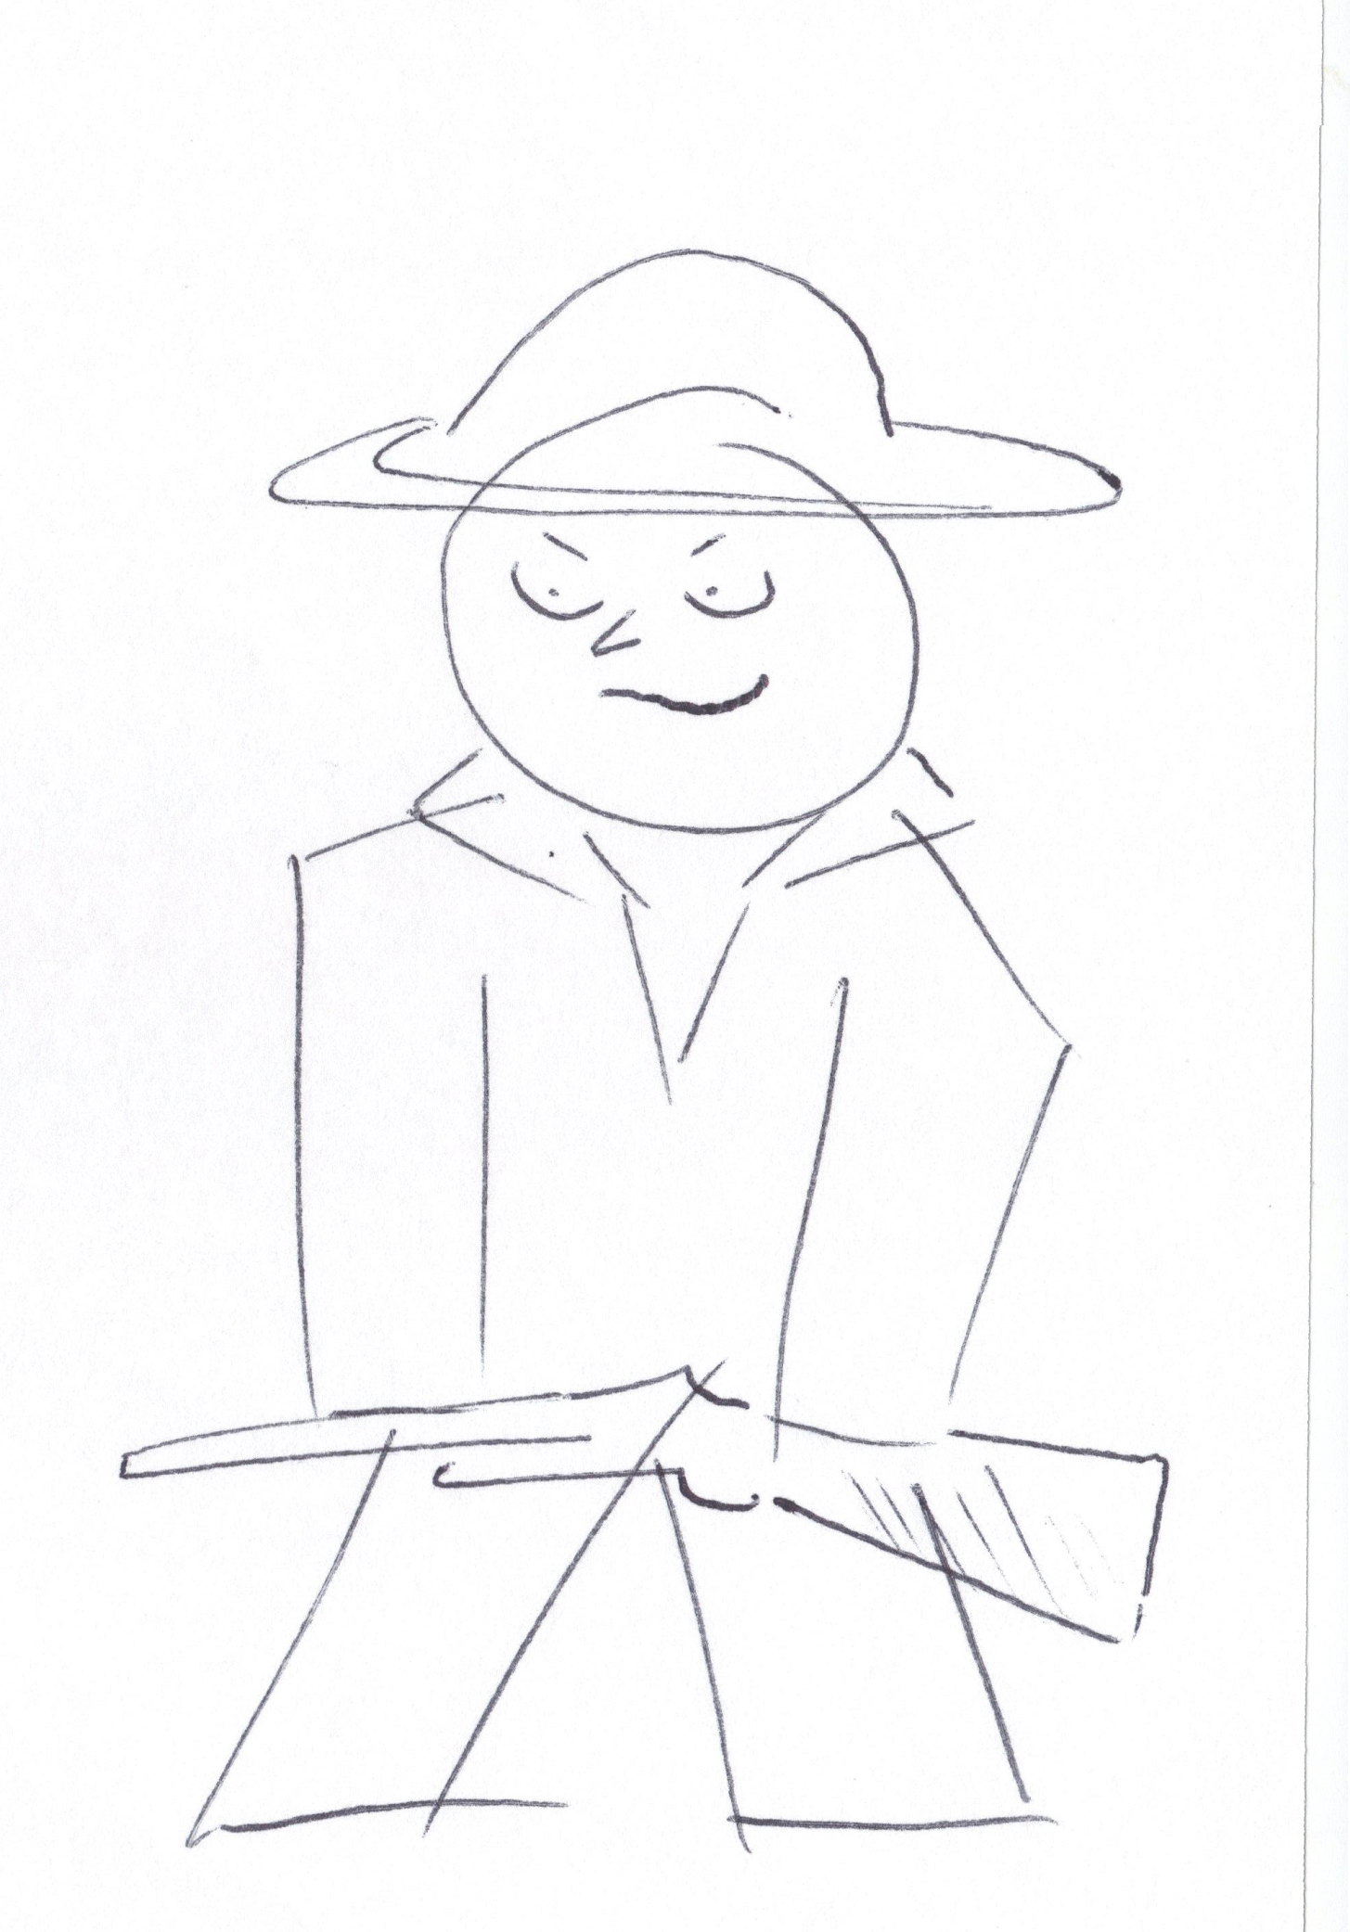
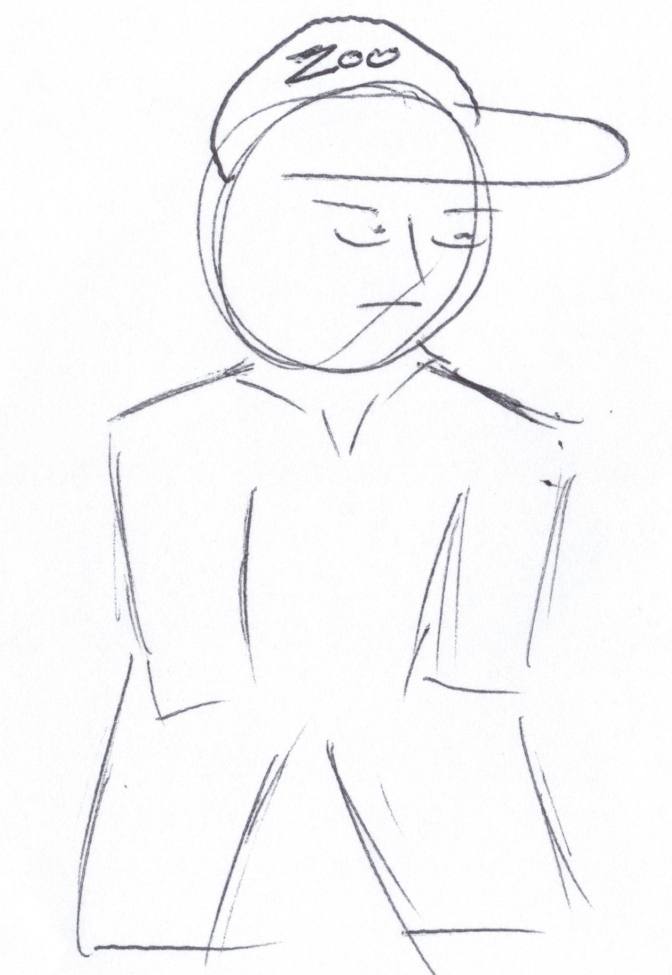
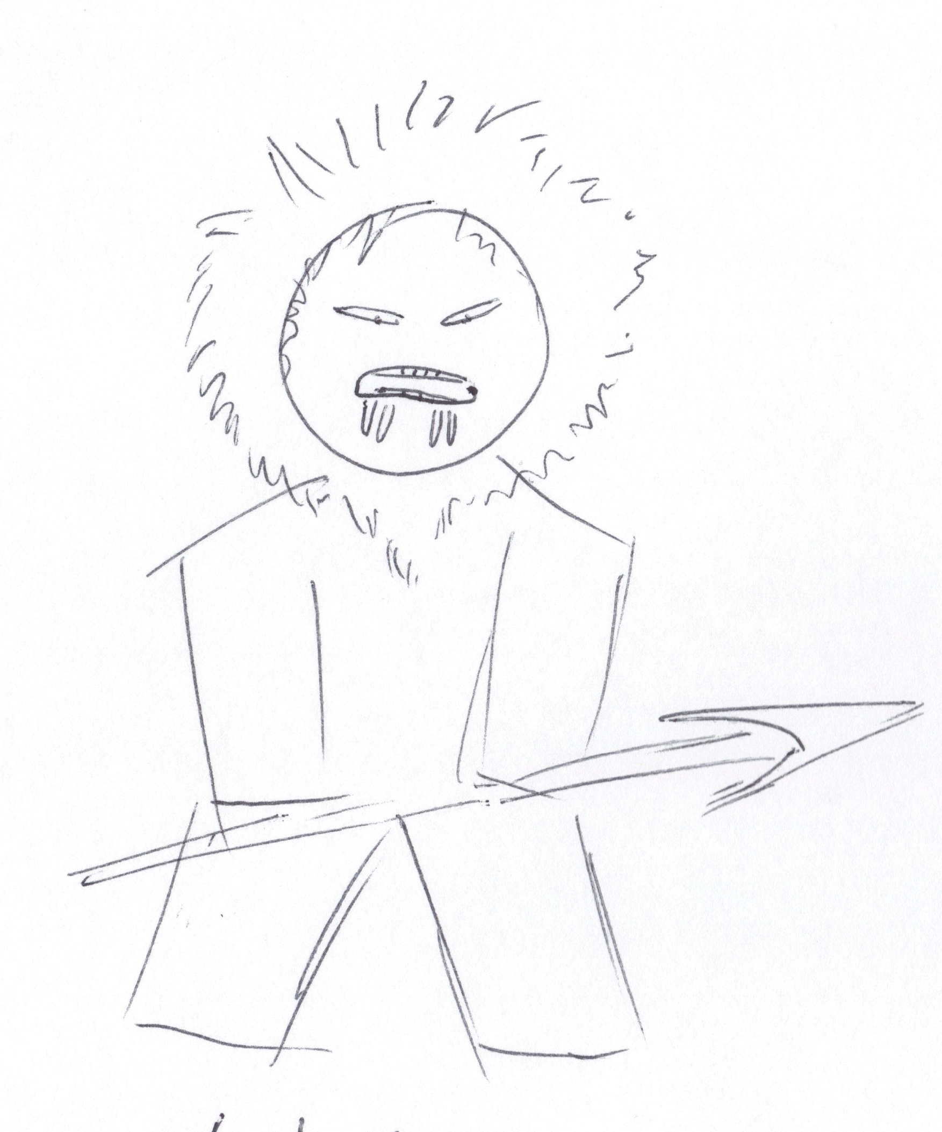
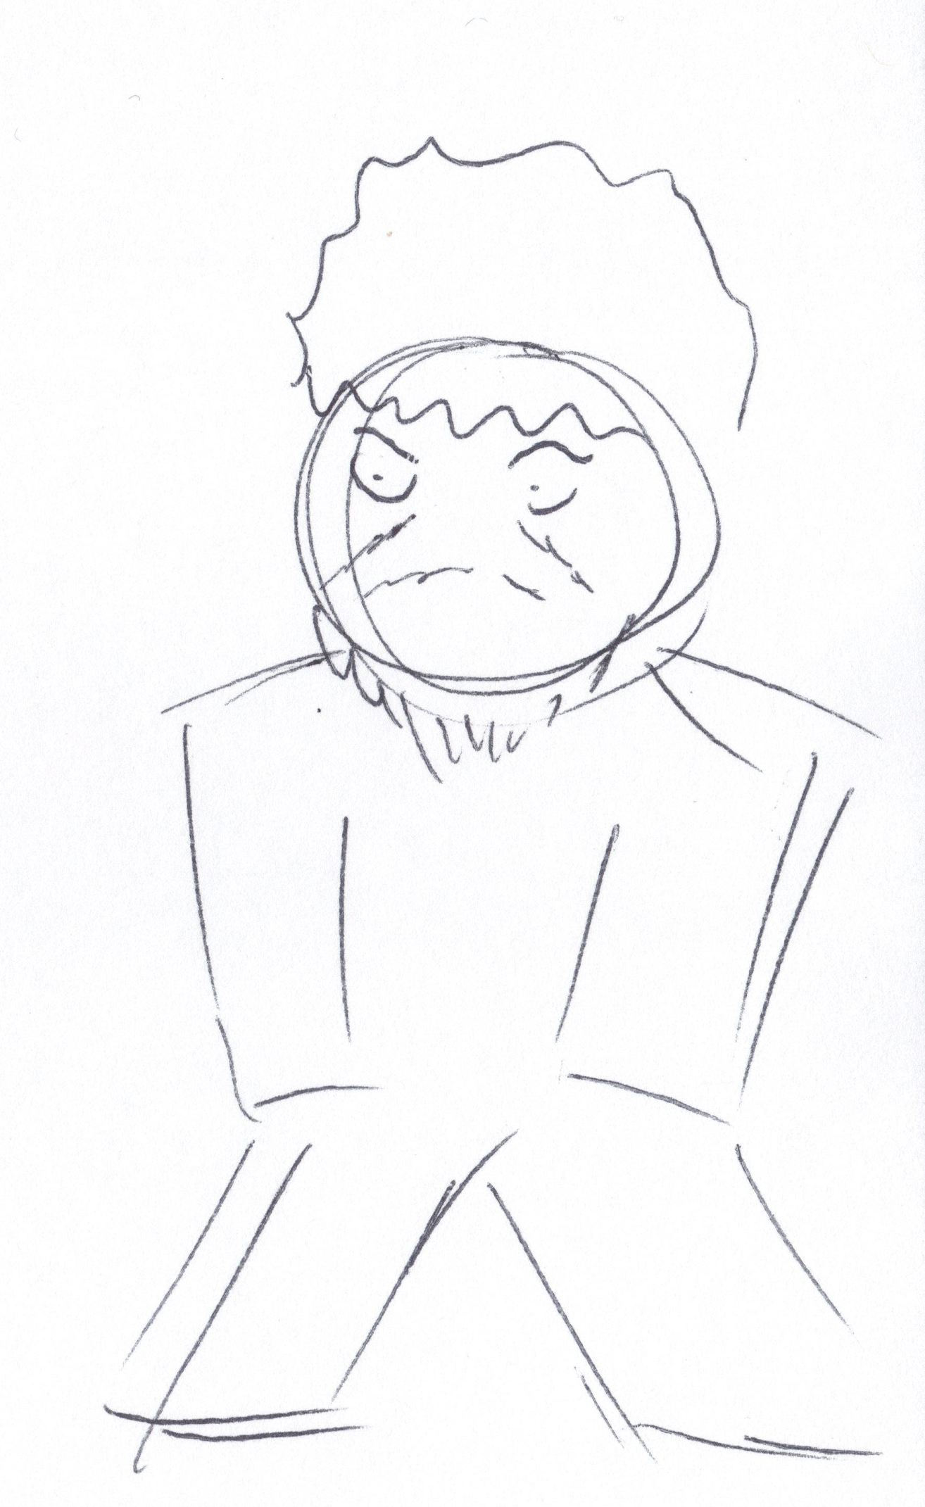
CHARACTERS
ZOOKEEPER
POACHER
LEVEL 1 : ARCTIC FOX TRAPPERS
LEVEL 2 : EXPLORERS/DODO HATERS
LEVEL 3 : CAVEMEN

Slide 11



CHARACTERS - CONT

Slide 12
ACHIEVEMENTS
3 LEVELS OF ACHIEVEMENT FOR EACH LEVEL
BRONZE, SILVER, AND GOLD
EXAMPLES:
BRONZE : STUN 25% OF ALL ENEMIES IN LEVELS 1/2/3
SILVER: STUN 50% OF ALL ENEMIES IN LEVELS 1/2/3
GOLD: STUN 100% OF ENEMIES IN LEVELS 1/2/3
CLEAR X LEVEL, IN X TIME
Notes:
Aaron

Slide 13
PROTOTYPE
HORIZONTAL SIDE SCROLLING
BEING ABLE TO SHOW THE FIELD OF VIEW FOR POACHER
WORKING HP SYSTEM
HERO/ENEMY INTERACTION
BEING ABLE TO ENABLE UPGRADES
SHOW DIFFERENT ENEMY PATROL STATES
Notes:
Aaron

Slide 14
QUESTIONS

